Slide 1

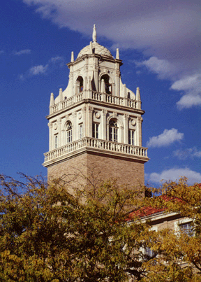
Reinforcement Learning Algorithms Code Implementation
Saif Al Wahaibi
PhD Candidate
___ ___, 20__

Slide 2
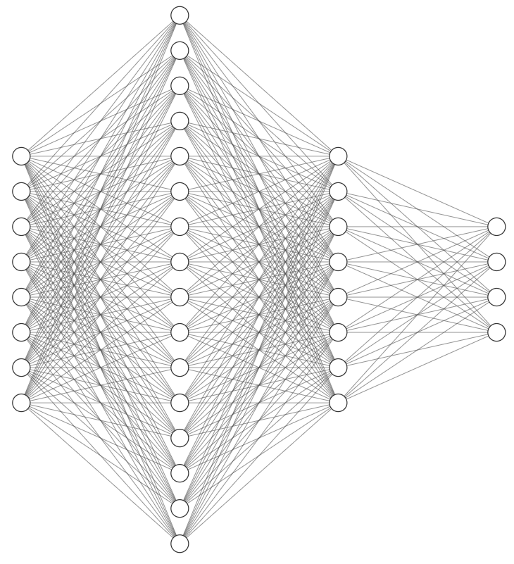




$Q$-Learning
Intuition:
Estimate $Q_{π}\left(s, a\right)$ via function approximation
Math:
$$𝒥\left(θ\right)=𝔼_{π}\left[{\left(δ_{TD}−{\hat{Q}}_{θ}\left(s,a\right)\right)}^{2}\right]=𝔼_{π}\left[{\left(r+γ\max_{a^{′}}{{\hat{Q}}_{θ}\left(s^{′},a^{′}\right)}−{\hat{Q}}_{θ}\left(s,a\right)\right)}^{2}\right]$$
$$→ {\hat{Q}}_{θ}\left(s, a_{1}\right)$$
$$⋮$$
$$→ {\hat{Q}}_{θ}\left(s, a_{n}\right)$$
$$s →$$

Slide 3


$Q$-Learning Algorithm
Pseudocode:
Initialize ${\hat{Q}}_{θ}\left(s,a\right)$ with random weights
for episode = 1, 2, 3, …, E do
Initialize environment $s_{0}$
for t = 0, 1, 2, …, T do
Select action $a_{t}$ randomly with probability $ε$, otherwise
$a_{t}=\underset{a_{t}}{argmax}{{\hat{Q}}_{θ}\left(s_{t},a_{t}\right)}$
Execute action $a_{t}$ in environment and observe $r_{t+1}$, $s_{t+1}$, and terminal or truncate flags
Set TD target $δ_{TD}=r_{t+1}$ if terminal or truncate, otherwise $δ_{TD}=r_{t+1}+γ\max_{a_{t+1}}{{\hat{Q}}_{θ}\left(s_{t+1},a_{t+1}\right)}$
Perform a gradient descent step on
$𝒥\left(θ\right)=𝔼_{π}\left[{\left(δ_{TD}−{\hat{Q}}_{θ}\left(s_{t},a_{t}\right)\right)}^{2}\right]$
Set $s_{t+1}$ as current state
end for
end for

Slide 4
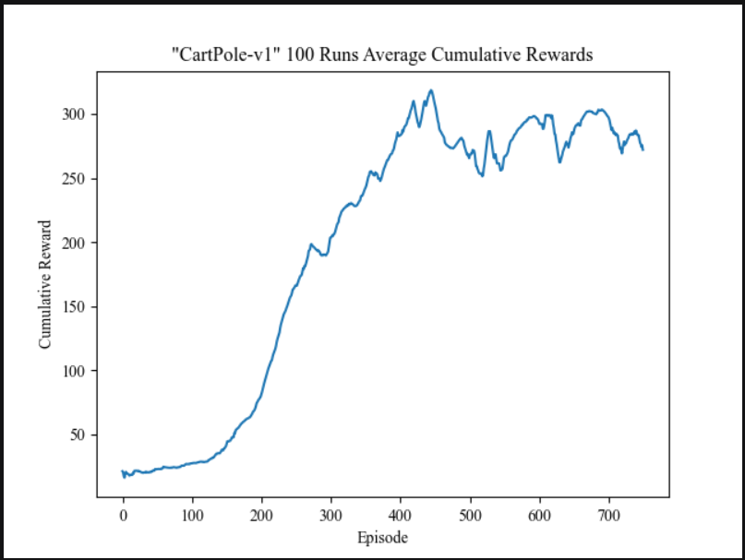

$Q$-Learning Example
“CartPole-v1” Gym Environment:

Slide 5




Double $Q$-Learning
Intuition:
Estimate $Q_{π}\left(s, a\right)$ via function approximation
Use two $Q$-networks to handle maximization bias
( )×2
$$→ {\hat{Q}}_{θ_{x}}\left(s, a_{1}\right)$$
$$⋮$$
$$→ {\hat{Q}}_{θ_{x}}\left(s, a_{n}\right)$$
$$s →$$

Slide 6

Double $Q$-Learning
Example of Maximization Bias:
Assume $\hat{Q}=150$
10 noisy estimates of $\hat{Q}$:
Another 10 noisy estimates of $\hat{Q}$ generated similarly but independently:
Math:
$$𝒥\left(θ_{i}\right)=𝔼_{π}\left[{\left(r+γ{\hat{Q}}_{θ_{j}}\left(s^{′}, \underset{a^{′}}{argmax}{{\hat{Q}}_{θ_{i}}\left(s^{′},a^{′}\right)}\right)−{\hat{Q}}_{θ_{i}}\left(s,a\right)\right)}^{2}\right]$$
1 | 2 | 3 | 4 | 5 | 6 | 7 | 8 | 9 | 10
150 | 151 | 151 | 150 | 151 | 151 | 151 | 152 | 150 | 149
1 | 2 | 3 | 4 | 5 | 6 | 7 | 8 | 9 | 10
150 | 151 | 147 | 151 | 151 | 150 | 150 | 150 | 151 | 148

Slide 7


Double $Q$-Learning Algorithm
Pseudocode:
Initialize both ${\hat{Q}}_{θ_{x}}\left(s,a\right)$ with random weights
for episode = 1, 2, 3, …, E do
Initialize environment $s_{0}$
for t = 0, 1, 2, …, T do
Select action $a_{t}$ randomly with probability $ε$, otherwise
$a_{t}=\underset{a_{t}}{argmax}\left(\frac{{\hat{Q}}_{θ_{1}}\left(s_{t},a_{t}\right) + {\hat{Q}}_{θ_{2}}\left(s_{t},a_{t}\right)}{2}\right)$
Execute action $a_{t}$ in environment and observe $r_{t+1}$, $s_{t+1}$, and terminal or truncate flags
Choose at random either to update 1 or 2
if i = 1 or 2 then
Set TD target $δ_{TD}=r_{t+1}$ if terminal or truncate, otherwise
${a^{∗}}_{t+1}=\underset{a_{t+1}}{argmax}{{\hat{Q}}_{θ_{i}}\left(s_{t+1},a_{t+1}\right)}$
$δ_{TD}=r_{t+1}+γ{\hat{Q}}_{θ_{3−i}}\left(s_{t+1},{a^{∗}}_{t+1}\right)$

Slide 8

Double $Q$-Learning Algorithm
${a^{∗}}_{t+1}=\underset{a_{t+1}}{argmax}{{\hat{Q}}_{θ_{i}}\left(s_{t+1},a_{t+1}\right)}$
$δ_{TD}=r_{t+1}+γ{\hat{Q}}_{θ_{3−i}}\left(s_{t+1},{a^{∗}}_{t+1}\right)$
Perform a gradient descent step on
$𝒥\left(θ\right)=𝔼_{π}\left[{\left(δ_{TD}−{\hat{Q}}_{θ_{i}}\left(s_{t},a_{t}\right)\right)}^{2}\right]$
end if
Set $s_{t+1}$ as current state
end for
end for

Slide 9
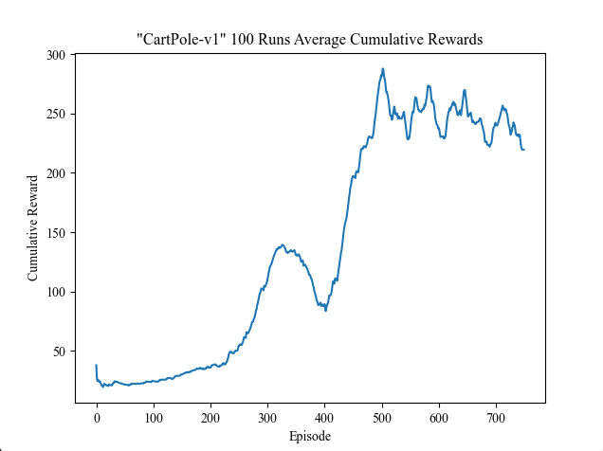

Double $Q$-Learning Example
“CartPole-v1” Gym Environment:

Slide 10






Deep $Q$-Learning Network
Intuition:
Estimate $Q_{π}\left(s, a\right)$ via function approximation
Use two $Q$-networks, one frozen and the other online, to fix the TD-target
Utilize a replay buffer to store experience and train networks in randomized batches
$$→ {\hat{Q}}_{θ^{′}}\left(s, a_{1}\right)$$
$$⋮$$
$$→ {\hat{Q}}_{θ^{′}}\left(s, a_{n}\right)$$
$$→ {\hat{Q}}_{θ}\left(s, a_{1}\right)$$
$$⋮$$
$$→ {\hat{Q}}_{θ}\left(s, a_{n}\right)$$
$$s →$$
$$s →$$
Math:
$$𝒥\left(θ\right)=𝔼_{π}\left[{\left(r+γ\max_{a^{′}}{{\hat{Q}}_{θ^{′}}\left(s^{′},a^{′}\right)}−{\hat{Q}}_{θ}\left(s,a\right)\right)}^{2}\right]$$

Slide 11


Deep $Q$-Learning Network Algorithm
Pseudocode:
Initialize both ${\hat{Q}}_{θ}\left(s,a\right)$ & ${\hat{Q}}_{θ^{′}}\left(s,a\right)$ with random weights
Initialize replay buffer
for episode = 1, 2, 3, …, E do
Initialize environment $s_{0}$
for t = 0, 1, 2, …, T do
Select action $a_{t}$ randomly with probability $ε$, otherwise
$a_{t}=\underset{a_{t}}{argmax}{{\hat{Q}}_{θ}\left(s_{t},a_{t}\right)}$
Execute action $a_{t}$ in environment and observe $r_{t+1}$, $s_{t+1}$, and terminal or truncate flags
Save $s_{t}$, $a_{t}$, $r_{t+1}$, $s_{t+1}$, and terminal or truncate flags in replay buffer
Sample a random batch of ${s^{ℛ}}_{t}$, ${a^{ℛ}}_{t}$, ${r^{ℛ}}_{t+1}$, ${s^{ℛ}}_{t+1}$, and terminal or truncate flags from replay buffer
Set TD target $δ_{TD}={r^{ℛ}}_{t+1}$ if terminal or truncate, otherwise
$δ_{TD}={r^{ℛ}}_{t+1}+γ\max_{{a^{ℛ}}_{t+1}}{{\hat{Q}}_{θ^{′}}\left({s^{ℛ}}_{t+1}, {a^{ℛ}}_{t+1}\right)}$

Slide 12

Deep $Q$-Learning Network Algorithm
Set TD target $δ_{TD}={r^{ℛ}}_{t+1}$ if terminal or truncate, otherwise
$δ_{TD}={r^{ℛ}}_{t+1}+γ\max_{{a^{ℛ}}_{t+1}}{{\hat{Q}}_{θ^{′}}\left({s^{ℛ}}_{t+1}, {a^{ℛ}}_{t+1}\right)}$
Perform a gradient descent step on
$𝒥\left(θ\right)=𝔼_{π}\left[{\left(δ_{TD}−{\hat{Q}}_{θ}\left({s^{ℛ}}_{t}, {a^{ℛ}}_{t}\right)\right)}^{2}\right]$
Count learning steps:
i = i + 1
if i = replace then
Update target network:
$θ^{′} ← θ$
end if
Set $s_{t+1}$ as current state
end for
end for

Slide 13
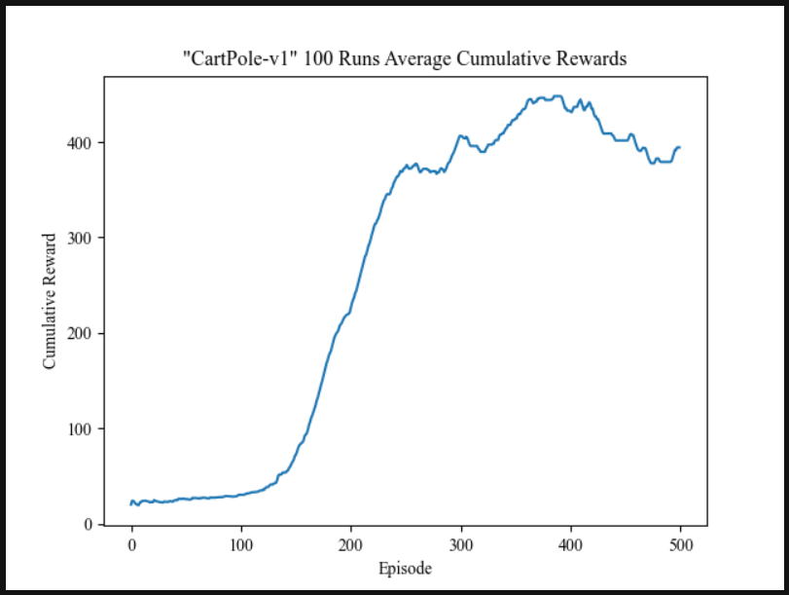

Deep $Q$-Learning Network Example
“CartPole-v1” Gym Environment:

Slide 14


Double Deep $Q$-Learning Network
Intuition:
Estimate $Q_{π}\left(s, a\right)$ via function approximation
Use two $Q$-networks, one frozen and the other online, to fix the TD-target
Utilize a replay buffer to store experience and train networks in randomized batches
Use the online and target $Q$-networks to handle maximization bias
Math:
$$𝒥\left(θ\right)=𝔼_{π}\left[{\left(r+γ{\hat{Q}}_{θ^{′}}\left(s^{′},\underset{a^{′}}{argmax}{{\hat{Q}}_{θ}\left(s^{′},a^{′}\right)}\right)−{\hat{Q}}_{θ}\left(s,a\right)\right)}^{2}\right]$$

Slide 15
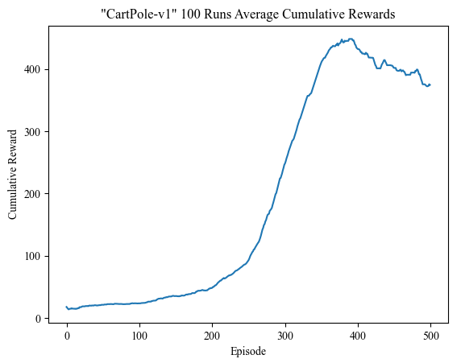

Double Deep $Q$-Learning Network Example
“CartPole-v1” Gym Environment:

Slide 16


